Slide 1
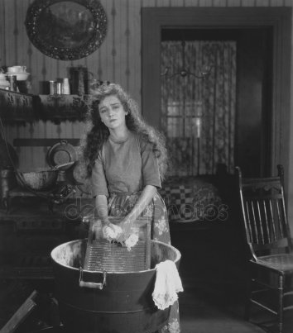
In old days laundry was done like this…

Slide 2
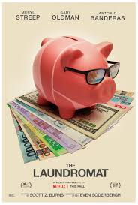
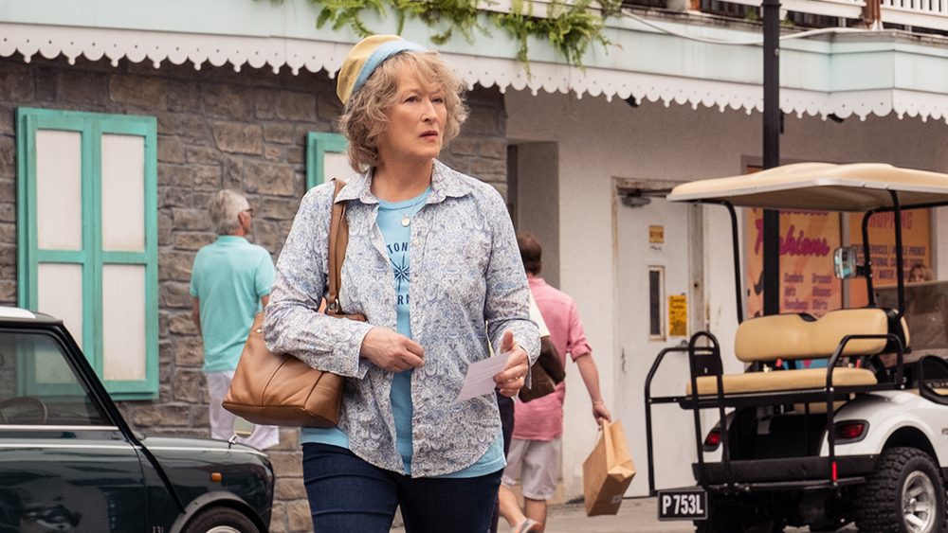
Nowadays women are thinking of combating laundry
… money laundry

Slide 3

#Laundrywomen
A HUGE problem for the business
CHF700\per case Credit Suisse costs to check suspicious cases

Slide 4
Hypotheses
Customer’s country is a very important risk feature
Explanatory power can be improved by adding new data sources
High cash activity is likely to indicate money laundering
Feature interaction: a set of models is more indicative than individual features

Slide 5
Our Approach
Research on the topic to identify financial criminals behaviour
Two additional data sources
Basel AML Index*
Corruption Perceptions Index 2018**
*is an independent annual ranking that assesses the risk of money laundering and terrorist financing around the world
**CPI by Transparency International - ranks 180 countries by their perceived levels of public sector corruption according to experts and businesspeople

Slide 6
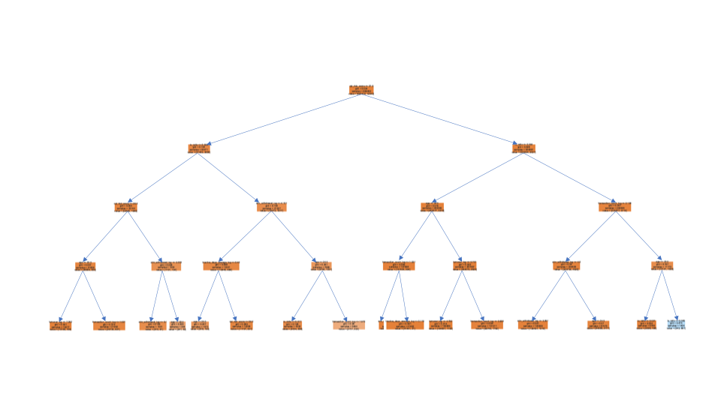
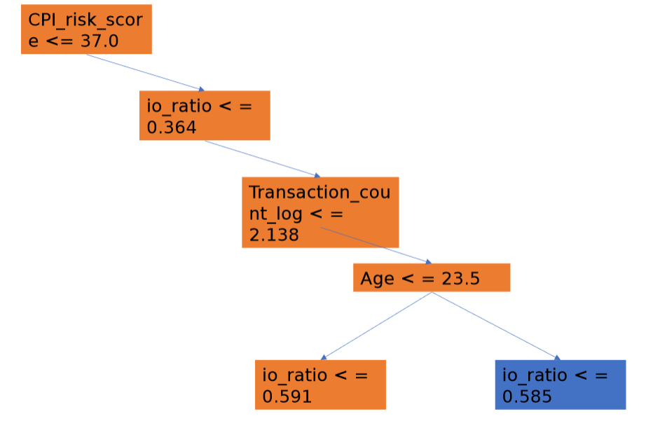
Money doesn’t grow on trees, but as data scientists we can grow decision trees

Slide 7
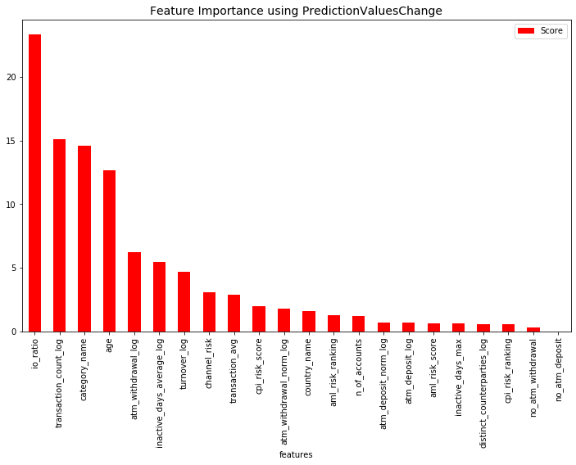
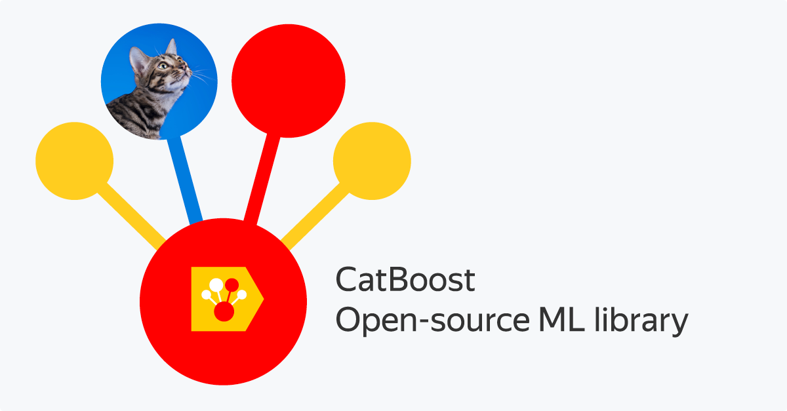
To boost perfectly, we used boosting algorithm. But as we know from Instagram, everything is better with cats, so we settled on CatBoost

Slide 8
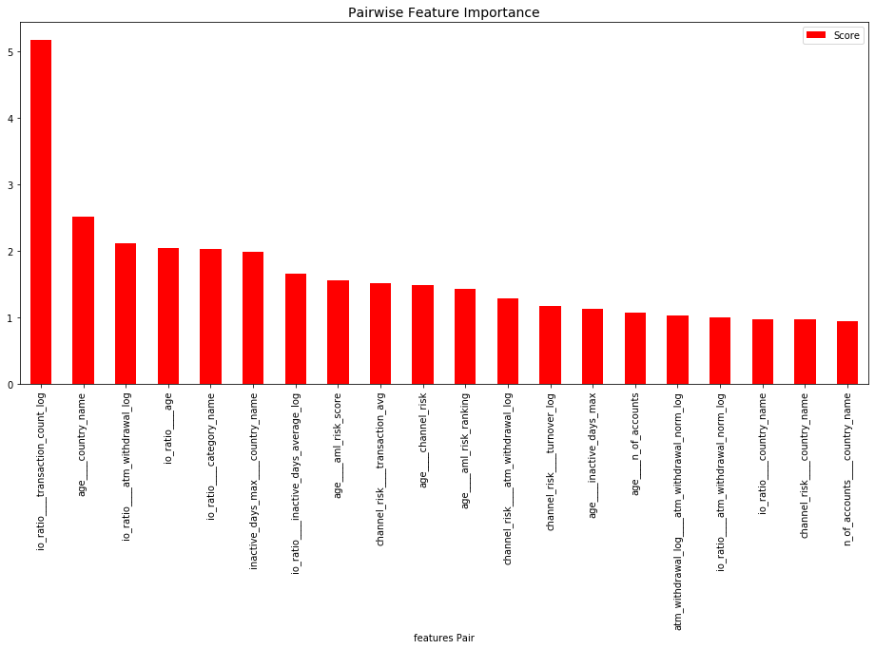
CatBoost Feature Interaction

Slide 9
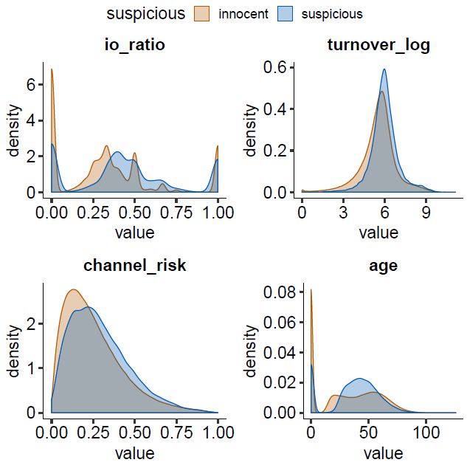
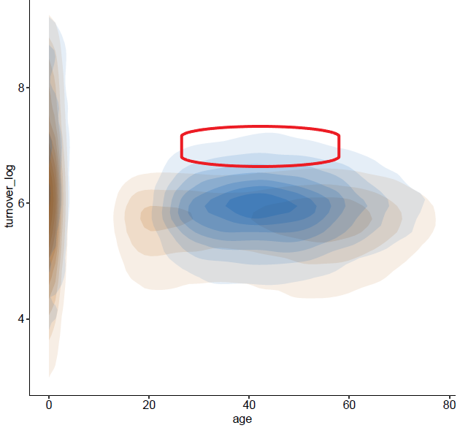
Predictive features and feature interaction

Slide 10
Findings
Output: two models that either report maximum of suspicious cases or minimizes number of flagged innocent to keep bank costs small
Feature Interaction: a combination of the features increases explanatory power
Identified the most influential features to identify suspicious behaviour in both models:
i\o ratio
Age
Transaction count
Average of inactive days
ATM Withdrawal
Outlook for future research:
- The models have better performance potential if including geopolitical data

Slide 11


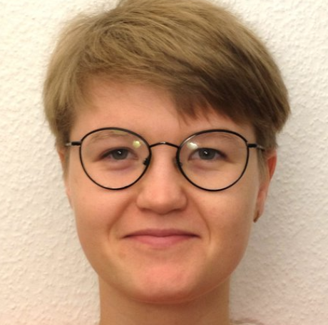
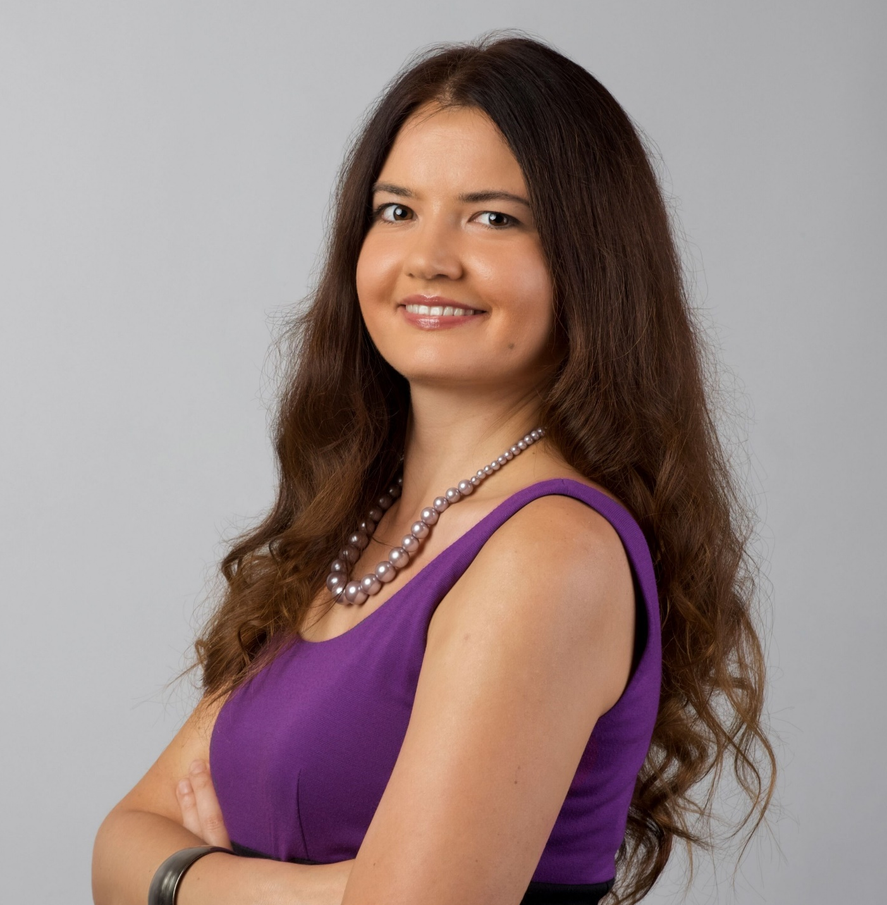

WonderLaundryWomen Team
Maria Heinatz – Cleaning Lady
Jelena Čuklina – Graphic Lady
Yulia Gazizova – Cat Lady
Ziva Tavcar – Managing Lady
Marina Shkapina – Housekeeping Lady

